Slide 1

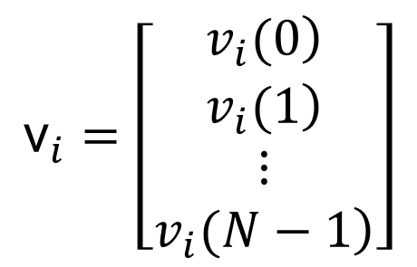
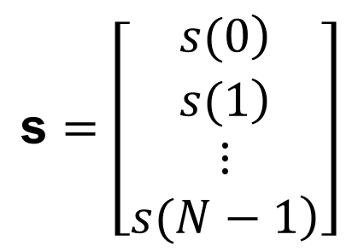
Señal promediada
Consideramos un modelo,
$${\text{x}}_{i}=s+{\text{v}}_{i}$$
$$\text{s}=\left[\begin{matrix}\left.s(0\right) \\ \begin{matrix}\left.s(1\right) \\ \begin{matrix}⋮ \\ \left.s(N−1\right)\end{matrix}\end{matrix}\end{matrix}\right]$$
$${\text{v}}_{i}=\left[\begin{matrix}\left.v_{i}(0\right) \\ \begin{matrix}\left.v_{i}(1\right) \\ \begin{matrix}⋮ \\ \left.v_{i}(N−1\right)\end{matrix}\end{matrix}\end{matrix}\right]$$
siendo
y

Slide 2

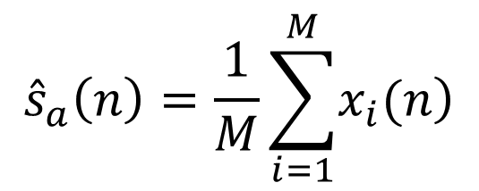
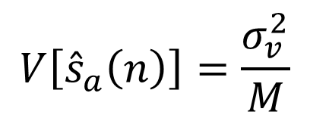
$${\hat{s}}_{a}\left(n\right)=\frac{1}{M}\sum_{i=1}^{M}{\left.x_{i}(n\right)}$$
promedio en el ensamble es un estimado insesgado
$$\left.E\left[{\hat{s}}_{a}\left(n\right)\right]=s(n\right)$$
mientras que la varianza será
$$V\left[{\hat{s}}_{a}\left(n\right)\right]=\frac{σ_{v}^{2}}{M}$$

Slide 3

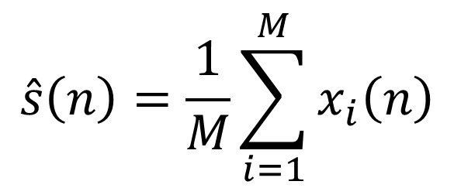
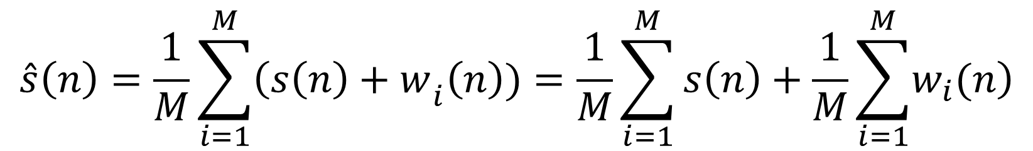
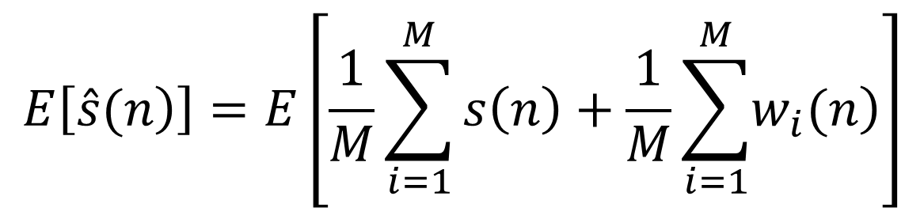
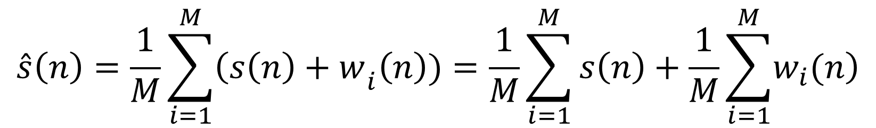
$$\hat{s}\left(n\right)=\frac{1}{M}\sum_{i=1}^{M}{{\left(s\left(n\right)+w\right.}_{i}\left(n\right))=\frac{1}{M}\sum_{i=1}^{M}{s\left(n\right)+\frac{1}{M}\sum_{i=1}^{M}{\left.w_{i}(n\right)}}}$$
Estimación de señal promediada, análisis media
$$\hat{s}\left(n\right)=\frac{1}{M}\sum_{i=1}^{M}{x_{i}\left(n\right)}$$
$$\left.x_{i}\left(n\right)=s\left(n\right)+w_{i}(n\right)$$
$$\hat{s}\left(n\right)=\frac{1}{M}\sum_{i=1}^{M}{{\left(s\left(n\right)+w\right.}_{i}\left(n\right))=\frac{1}{M}\sum_{i=1}^{M}{s\left(n\right)+\frac{1}{M}\sum_{i=1}^{M}{\left.w_{i}(n\right)}}}$$
$$E\left[\left.\hat{s}(n\right)\right]=E\left[\frac{1}{M}\sum_{i=1}^{M}{s\left(n\right)+\frac{1}{M}\sum_{i=1}^{M}{\left.w_{i}(n\right)}}\right]$$

Slide 4
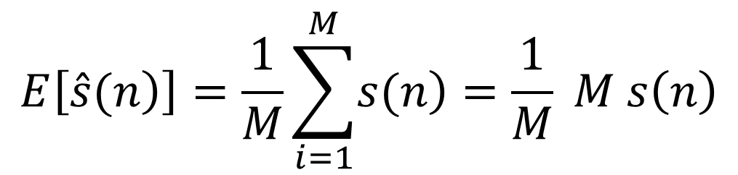
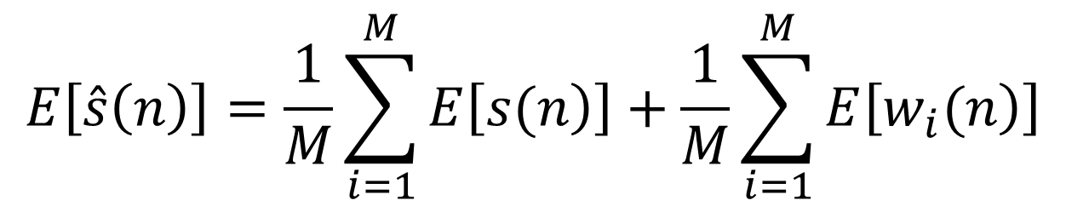

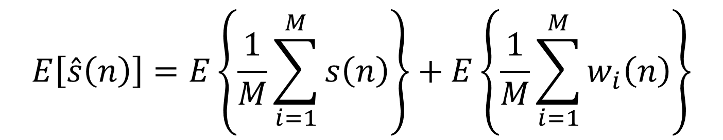

$$E\left[\hat{s}\left(n\right)\right]=E\left\{\frac{1}{M}\sum_{i=1}^{M}{s\left(n\right)}\right\}+E\left\{\frac{1}{M}\sum_{i=1}^{M}{w_{i}\left(n\right)}\right\}$$
$$E\left[\hat{s}\left(n\right)\right]=\frac{1}{M}\sum_{i=1}^{M}{E\left[\left.s(n\right)\right]}+\frac{1}{M}\sum_{i=1}^{M}{E\left[\left.w_{i}(n\right)\right]}$$
$$E\left[\left.\hat{s}(n\right)\right]=\frac{1}{M}\sum_{i=1}^{M}{\left.s(n\right)}=\frac{1}{M} M s\left(n\right)$$
$\left.E\left[\left.\hat{s}(n\right)\right]=s(n\right)$
estimador insesgado de
$$\left.s(n\right)$$

Slide 5
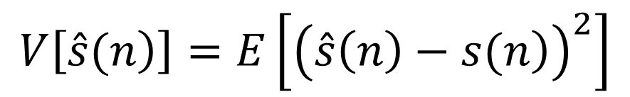

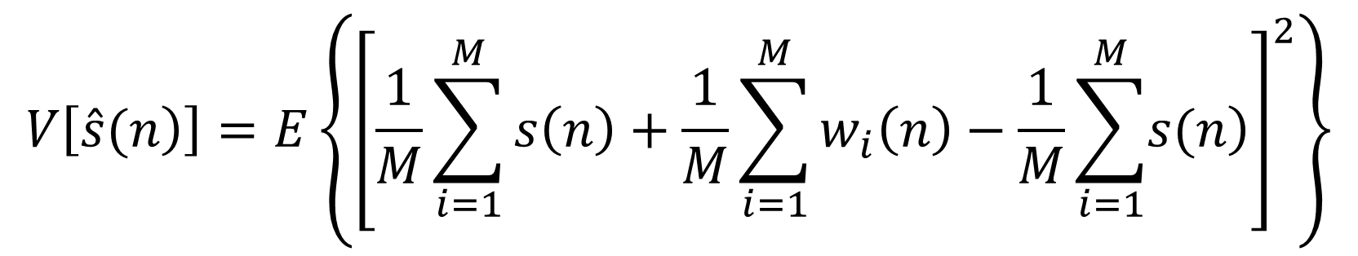
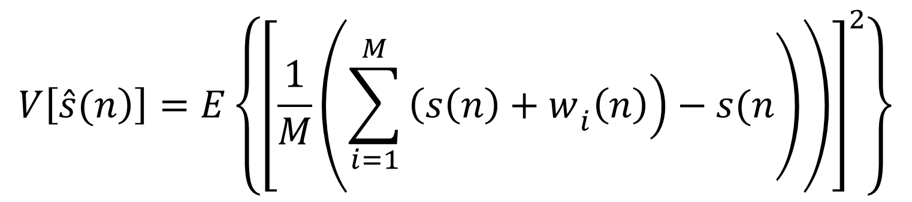
Estimación de Señal Promedida, análisis varianza
$$V\left[\left.\hat{s}(n\right)\right]=E\left[{\left(\hat{s}\left(n\right)−E\left[\left.\hat{s}(n\right)\right]\right)}^{2}\right]$$
$$V\left[\left.\hat{s}(n\right)\right]=E\left[{\left(\left.\hat{s}\left(n\right)−s(n\right)\right)}^{2}\right]$$
$$V\left[\left.\hat{s}(n\right)\right]=E\left\{{\left[\frac{1}{M}\left(\left.\sum_{i=1}^{M}{\left.{\left(s\left(n\right)+w\right.}_{i}\left(n\right)\right)}−s(n\right)\right)\right]}^{2}\right\}$$
$$V\left[\left.\hat{s}(n\right)\right]=E\left\{{\left[\frac{1}{M}\sum_{i=1}^{M}{s\left(n\right)+\frac{1}{M}}\sum_{i=1}^{M}{w_{i}\left(n\right)−\frac{1}{M}\sum_{i=1}^{M}{\left.s(n\right)}}\right]}^{2}\right\}$$

Slide 6
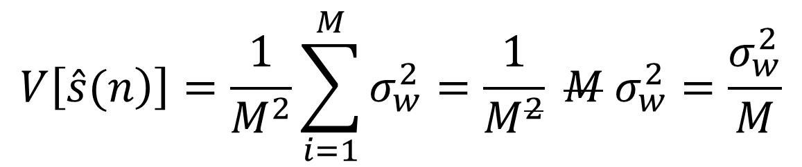
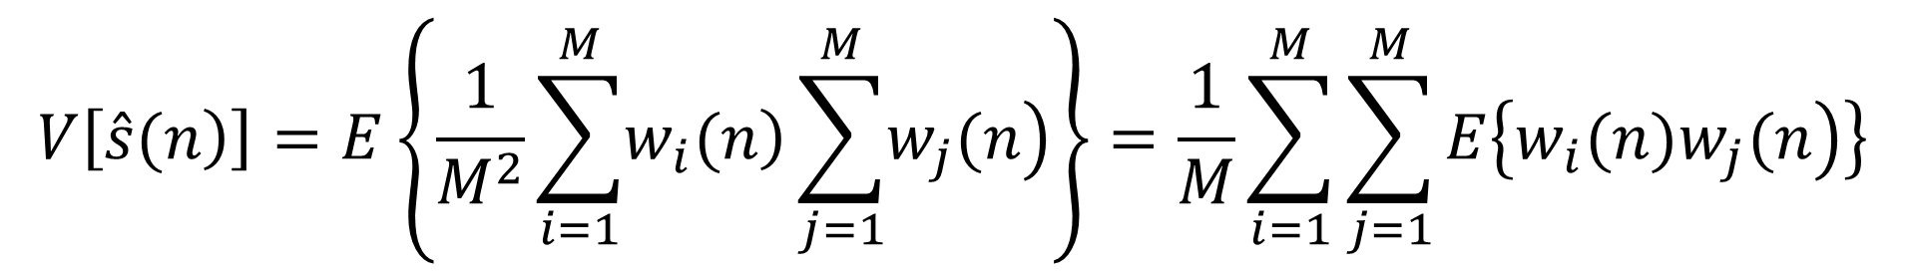


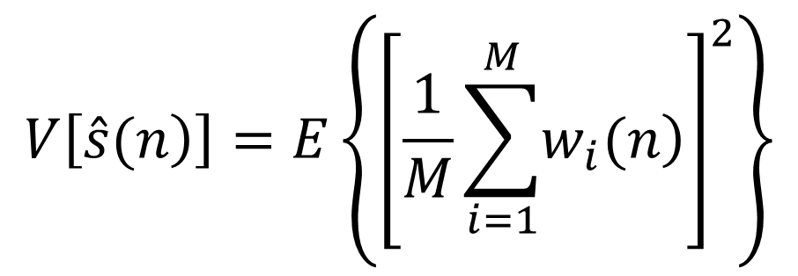
$$V\left[\left.\hat{s}(n\right)\right]=E\left\{{\left[\frac{1}{M}\sum_{i=1}^{M}{\left.w_{i}(n\right)}\right]}^{2}\right\}$$
$$V\left[\left.\hat{s}(n\right)\right]=E\left\{\frac{1}{M^{2}}\sum_{i=1}^{M}{\left.w_{i}(n\right)}\sum_{j=1}^{M}{\left.w_{j}(n\right)}\right\}=\frac{1}{M}\sum_{i=1}^{M}{\sum_{j=1}^{M}{E\left\{\left.w_{i}(n)w_{j}(n\right)\right\}}}$$
solo vale cuando
$$i=j$$
es decir, es no nula e igual a
$$σ_{w}^{2}$$
$$V\left[\left.\hat{s}(n\right)\right]=\frac{1}{M^{2}}\sum_{i=1}^{M}{σ_{w}^{2}}=\frac{1}{M^{2}} M{ σ}_{w}^{2}=\frac{σ_{w}^{2}}{M}$$

Slide 7
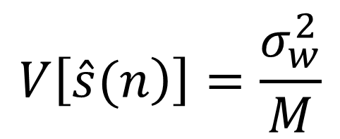
estimador sesgado de la varianza
$$V\left[\left.\hat{s}(n\right)\right]=\frac{σ_{w}^{2}}{M}$$

